Slide 1

Aircraft Risk and Safety Analysis
Sumaiya Abdullahi Osman

Slide 2
Agenda
1
2
3
4
5
OVERVIEW
BUSINESS UNDERSTANDING
DATA UNDERSTANDING
DATA ANALYSIS
RECOMMENDATIONS

Slide 3

Overview
To identify risk factors in aviation operations.
To explore insights that inform safety and operational decisions.
To help stakeholders assess the potential business risks and opportunity in aviation safety.

Slide 4
Business understanding
Understanding aviation risks and safety trends.
Evaluating relationships between weather conditions, risk categories, and flight schedules to guide safer aviation operations.
Key objectives:
Identify high risk patterns in operations.
Recommend safety measures and insights for business strategies.
Provide data backed analysis to assess new aviation ventures.
Business Problem:

Slide 5
Data understanding
The dataset, sourced from the National Transportation Safety Board, provides detailed records of aviation accidents and incidents from 1962 to 2023. It covers events in the United States and international waters, offering a reliable basis for analyzing safety risks and operational factors in the aviation industry.
Dataset on aviation incidents and operations.
Key variables:
Weather conditions: VMC vs. IMC
Risk categories: High, Moderate, Low, Minimal.
Flight schedule: Day/Night, Scheduled/Unscheduled.
Aircraft details: Make, Model, Engine Type

Slide 6
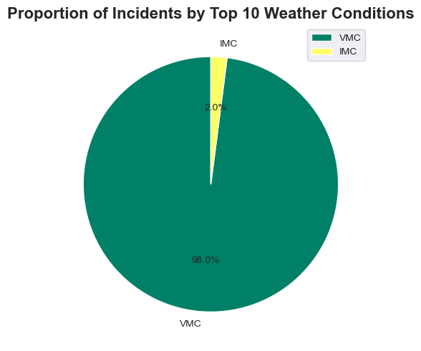
Data analysis
1. Weather Risk Insights:
VMC accounts for 98% of incidents, primarily moderate risk.
IMC has fewer incidents but relatively higher severity.

Slide 7
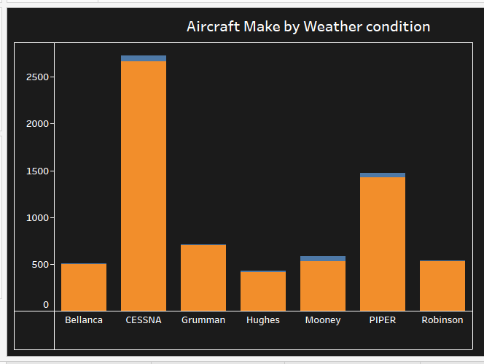
Data analysis
2. Aircraft Make:
Air Tractor and Piper dominate incident counts.

Slide 8
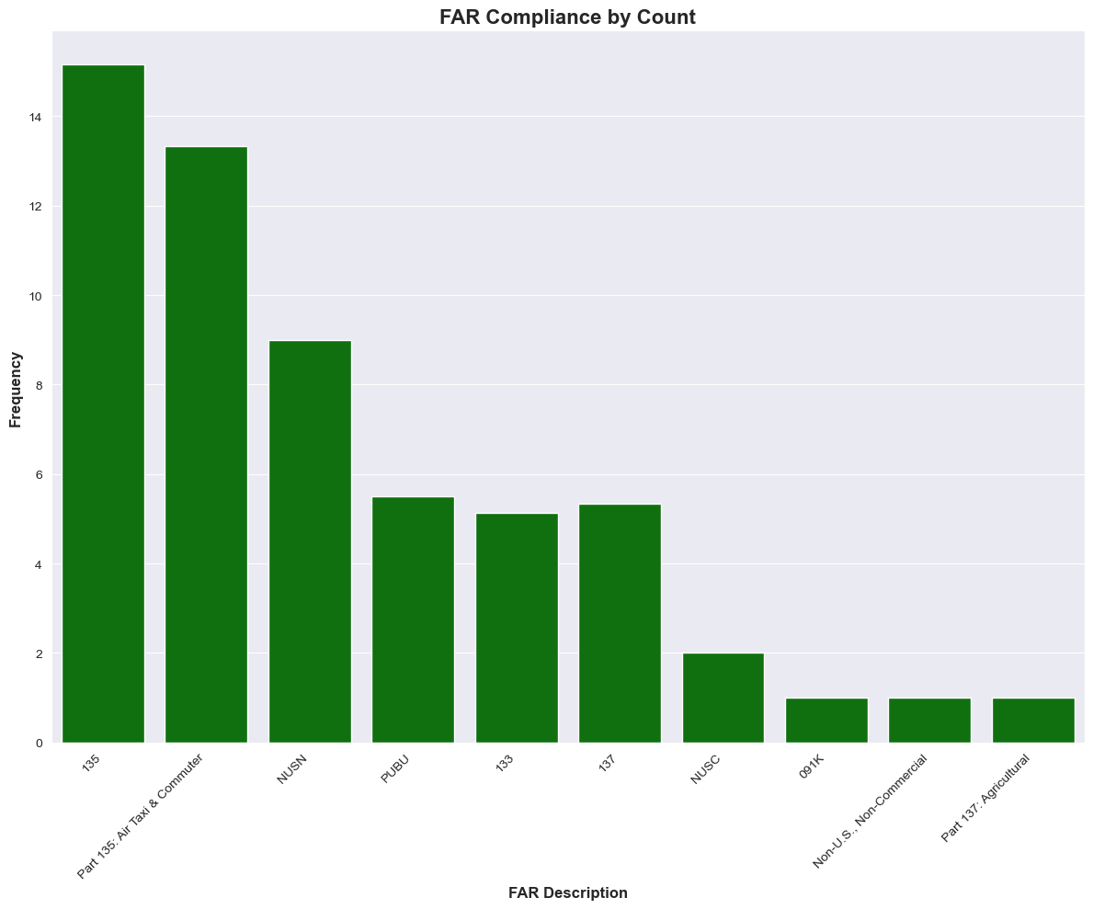
Data analysis
3. FAR Descriptions:
Part 135: Air Taxi & Commuter, 135, and NUSN have the highest incidents.

Slide 9
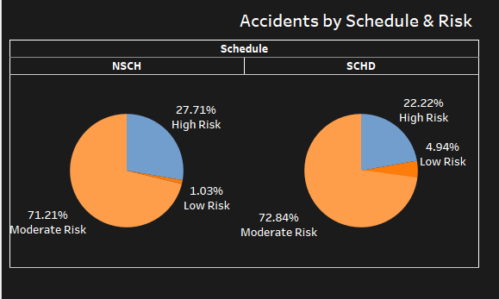
Data analysis
4. Flight Schedule:
Scheduled flights have higher incidents during the day.

Slide 10
Recommendations
. 1. Safety Focus During Takeoff and Landing: Given that these phases of flight show the highest risk, businesses should invest in technologies and procedures that enhance safety during these critical flight phases. This could include better pilot training, advanced navigation systems, or automatic landing assistance
5. Regulatory Compliance & Monitoring: New aviation businesses should ensure full compliance with FARs, especially Part 137 (Agricultural) and Part 135 (Air Taxi & Commuter). They should also establish internal monitoring systems to track FAR compliance and safety records, as these could impact the frequency of incidents.
3. Maintenance and Aircraft Type Monitoring: Frequent incidents with certain aircraft makes (e.g., Cessna, Piper, Air Tractor) suggest that routine maintenance schedules and monitoring should be prioritized, especially for aircraft used in high-risk sectors like agricultural aviation or air taxi services.
2. Pilot Training Programs: Businesses entering aviation should develop comprehensive pilot training programs focused on handling adverse weather, particularly in VMC conditions. Training should also emphasize incident management and risk mitigation during high-risk phases of flight.
4. Weather-Related Preparations: The high frequency of incidents during VMC highlights the need for weather-related preparedness. A weather monitoring system, real-time data integration, and contingency planning for weather disruptions would enhance safety and reduce incidents.

Slide 11

Next Steps
Short-Term Actions:
Implement visualized dashboards for risk monitoring.
Train pilots on risk management during day flights.
Long-Term Actions:
Develop predictive analytics for weather and risk trends.
Strengthen partnerships for compliance improvement in agricultural and air taxi categories.

Slide 12

Thank you
Questions:???
Sumaiya Abdullahi Osman
sumaiyaabdullahiosman@gmail.com
www.linkedin.com/in/sumaiya-abdullahi-osman-04954133b

